Slide 1

Sales Performance Analysis
Dinakar Kolla

Slide 2
Agenda
Overview of sales performance across regions and items.
Analyzing revenue and profit trends by selecting individual or multiple regions
Identifying high-performing regions and items to focus on for achieving sales targets.
Defining the goal to achieve 150% of current sales targets by region for each item.
Monitoring progress towards targets and making necessary adjustments for success.
dd

Slide 3
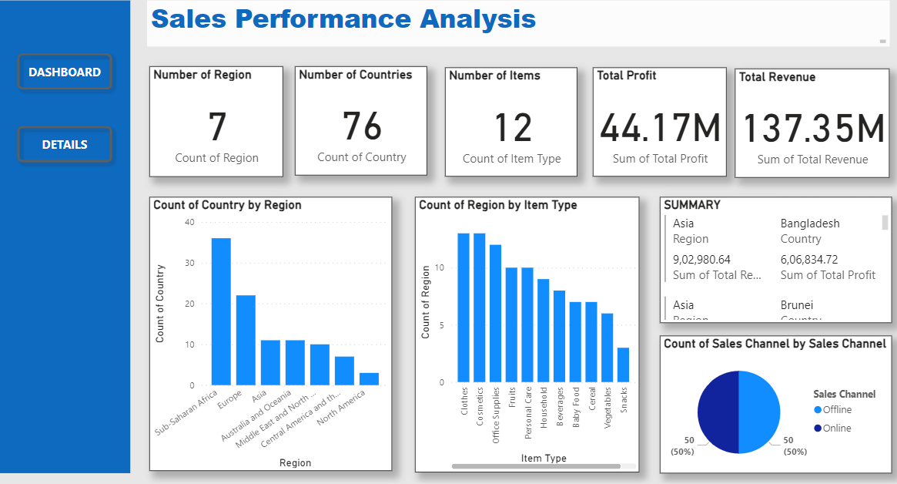
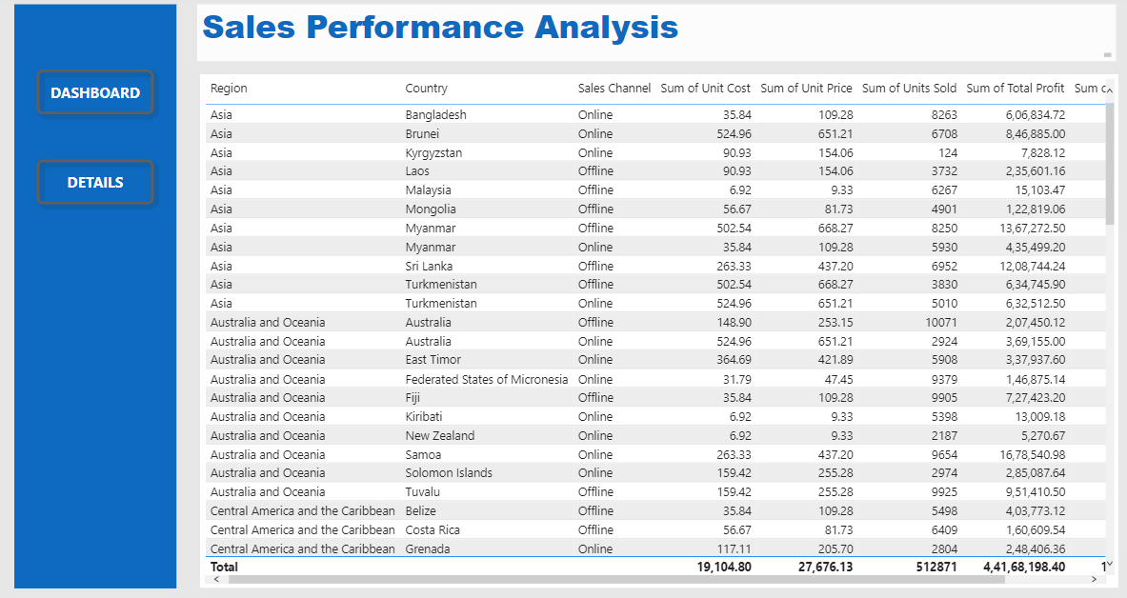
Overview on the whole sales performance analysis by region and country.
Developed a dashboard bookmark offering a high-level analysis of regions, countries, items, total profits, and total revenue based on units sold.
Added a 'Details' bookmark on the same page to represent all the data in a detailed table format for deeper insights.

Slide 4
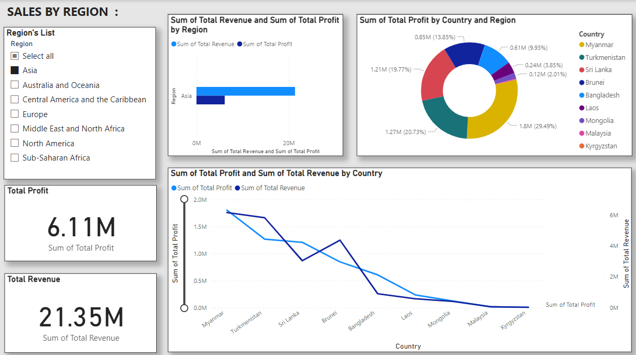
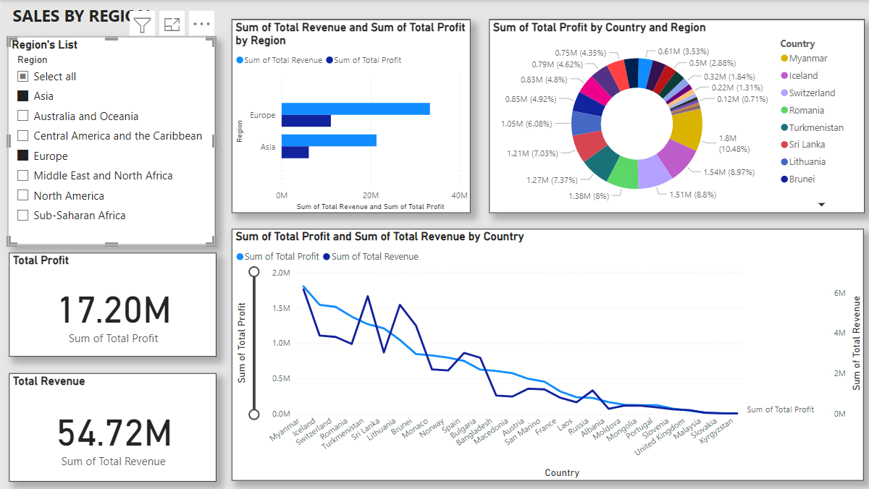
Overview Sales by Region
For Example:
By selecting Asia individually or combining regions like Asia and Europe, users can gain a clear analysis of total revenue and profit.
Users can click on regions in the slicer on the visual dashboard to filter data, and in the donut chart, they can view profit by country for deeper insights.

Slide 5
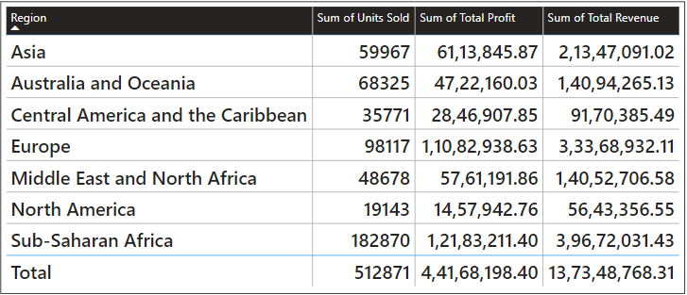
Total Sales By Region
Total sales
Visualize revenue and profit trends across regions to identify high-performing areas and regions with lower profitability.
Leverage insights from the chart to uncover growth opportunities, address regional disparities, and drive strategic decision-making for optimized performance.

Slide 6
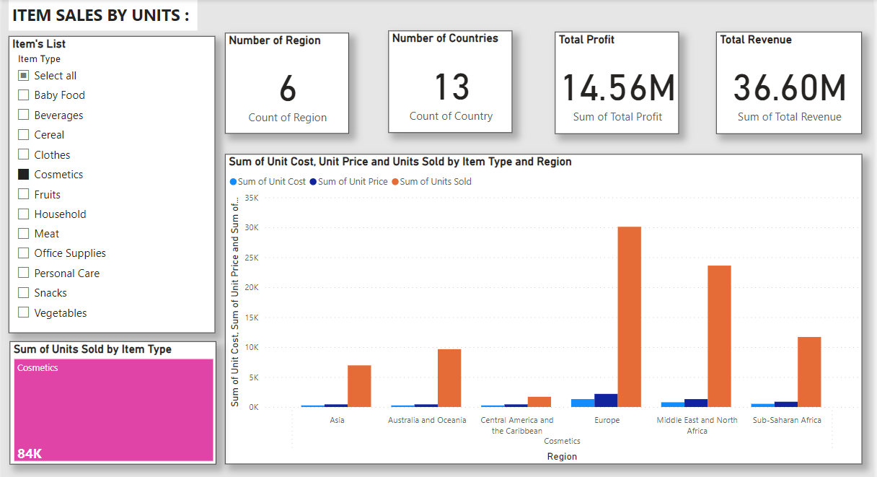
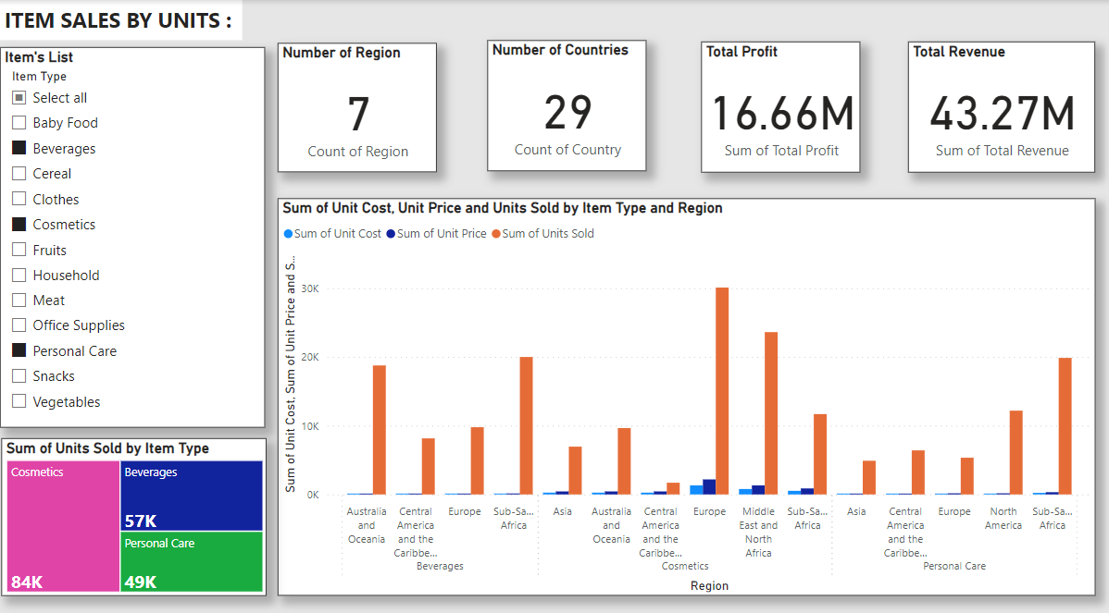
Overview Sales by Items
By selecting Cosmetics individually or combining regions like Cosmetics, Beverages and personal care, users can gain a clear analysis of total revenue and profit.
Users can click on Item list in the slicer on the visual dashboard to filter data, and in the bar chart and tree map, then they can view profit by country for deeper insights.

Slide 7
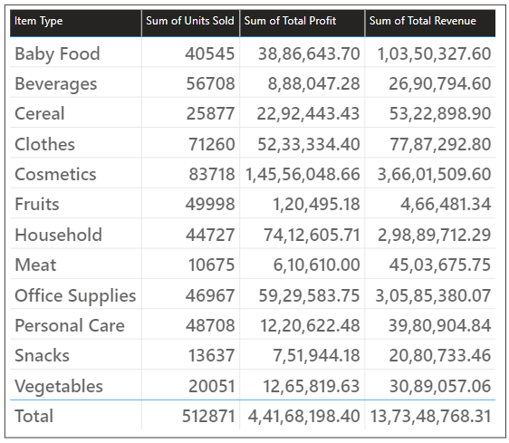
Total Sales By Items
Total sales
Visualize revenue and profit trends across regions to identify high-performing areas and items with lower profitability.
Leverage insights from the chart to uncover growth opportunities, address regional disparities, and drive strategic decision-making for optimized performance.

Slide 8
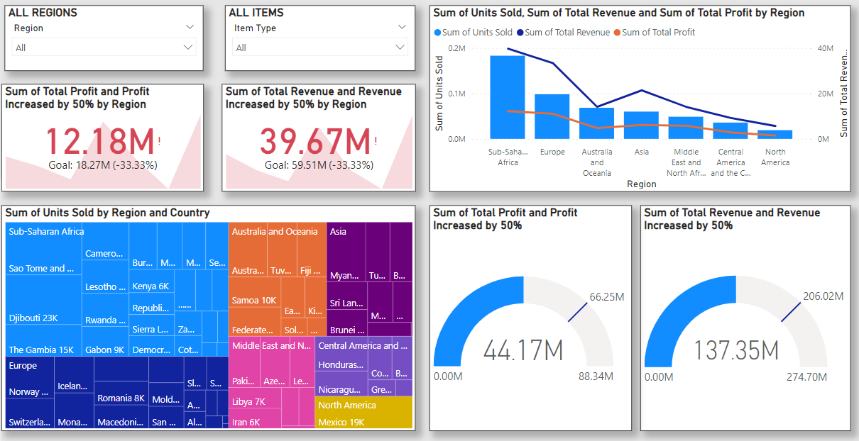
Targeted Sales for all regions
Target sales
The goal is to achieve 150% of current targets by region for each item, requiring focused efforts to exceed sales expectations and drive revenue growth.
Regular monitoring through dashboards will help track progress by region and item, ensuring timely adjustments to meet or surpass the target.

Slide 9
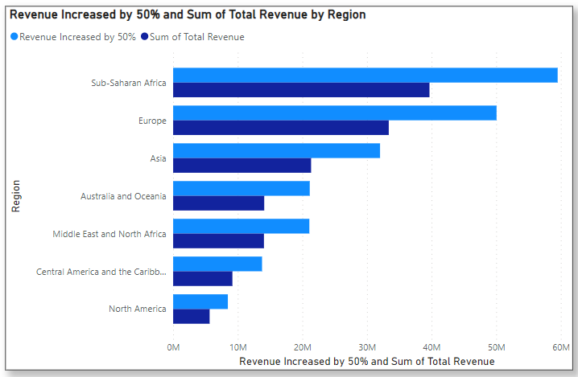
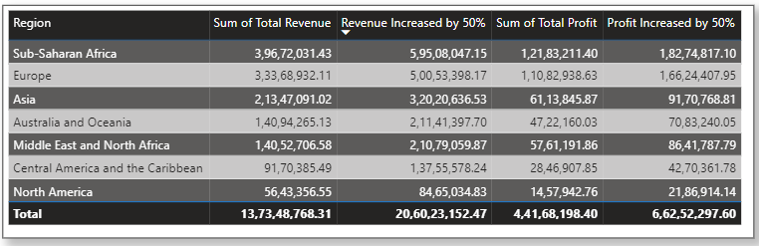
Summary
Sales target to be 150%

Slide 10
Thank you
Dinakar Kolla| Dinakarkolla8@gmail.com

